Slide 1
What’s New?
Approvals
Are automatic
No one needs to input the Approval String
Purchase Order #
NAV00000052
Travel – Meals – Citi card
No longer require PO’s
It is now called
Authorization
and done in the Expense Module
Associates are NOT Vendors

Slide 2
When we come across an Opportunity – How is it Resolved
If we come across a bug or opportunity our office puts in a “Ticket” to Drive Stream.
They will assign someone to our ticket and we will work together to resolve.
This is not always done on the timeline we may need.
Please be patient while we get thru the bugs and situations that didn’t come to mind while training and building the system.
Tip why something may not work
If the system wont search in a field - check for (white spaces).. Ex. TOM(hit spacebar) the system considers that a white space and may not search.
In Colleague we can use … as a search in Oracle you can sometimes use % Example – TOM%
In automatic search spaces (when you see the wheel turning) Less is more in these areas
Some screens are Associates Last Name, First Name

Slide 3
Procurement
Requisitions
Approvals
Receiving

Slide 4
Create a Requisition

Slide 5
#1 Click More Tasks
#2 Click Enter Req Line
See next slide
This is where you see all your Requisitions

Slide 6
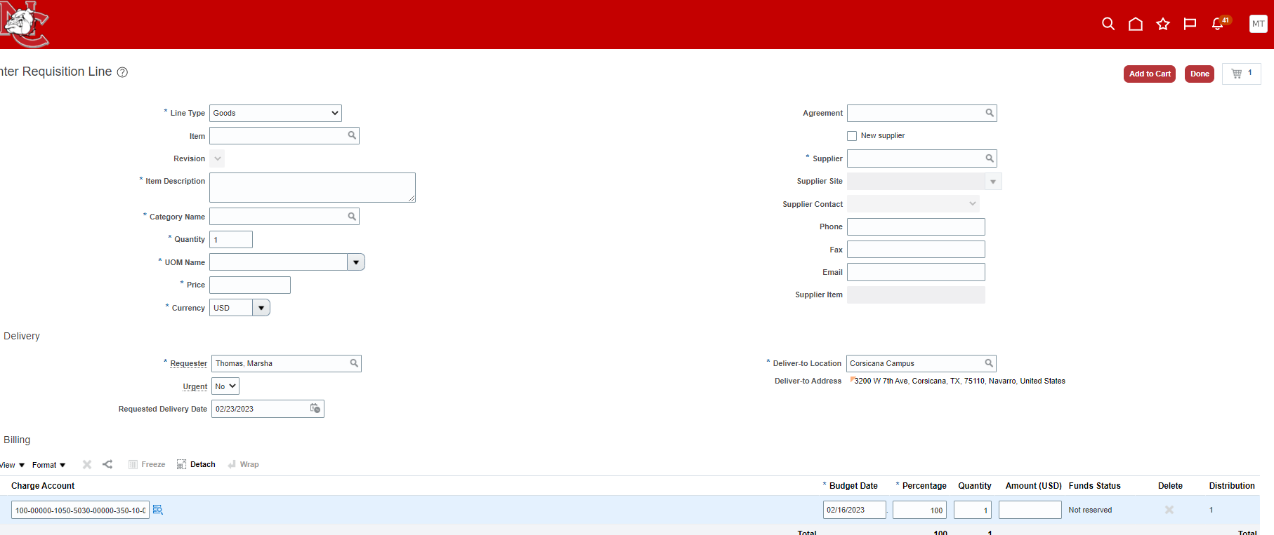
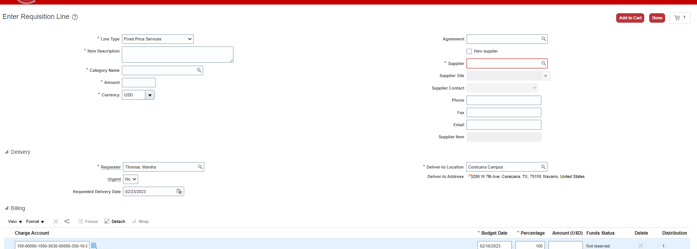
#3 Goods - Tangible
PO used one time and one per invoice.. Will NOT accept multiple invoices for the same po.
Or #3 Service
ONLY PO allowed to be used multiple times

Slide 7
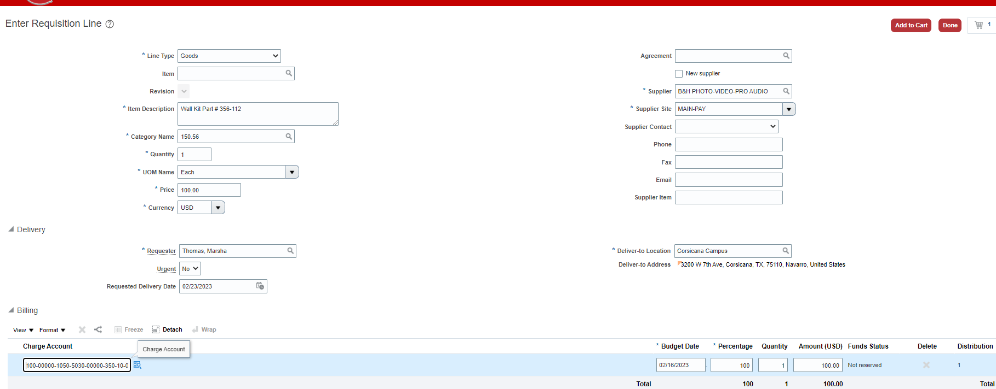
Add Items to Your Cart
#3 (previous screen)
#9 Select Supplier
Generates as you type
#4 Item Description
of EACH ITEM(separately) so the software can link the invoice to the po
#5 Category name is a # - click the magnify glass to search
#6- Qty
#7 – UOM name – EACH
Supplier Contact information will fill in when we go live.
#8 Price for each
#10 location of delivery
Urgent
See informational slide

Slide 8
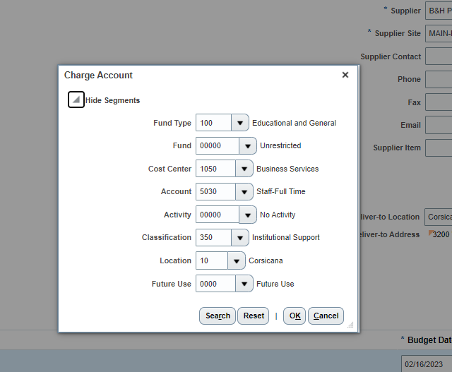
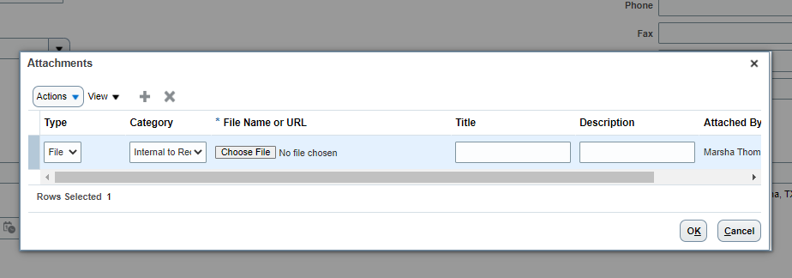
Bottom Portion of the Same page
See informational slide for more details on icons
Automatically fills in from above information you put in
#11 Click on blue box to put in your gl code
Opens this box to input
#12 Click the + to Attach your quote / Amazon Order

Slide 9
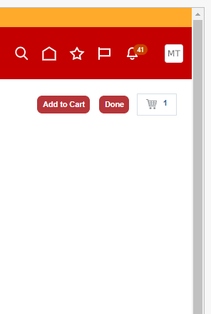
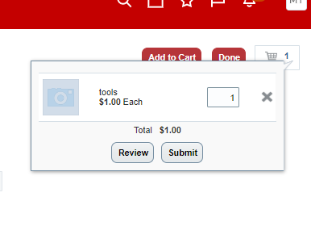
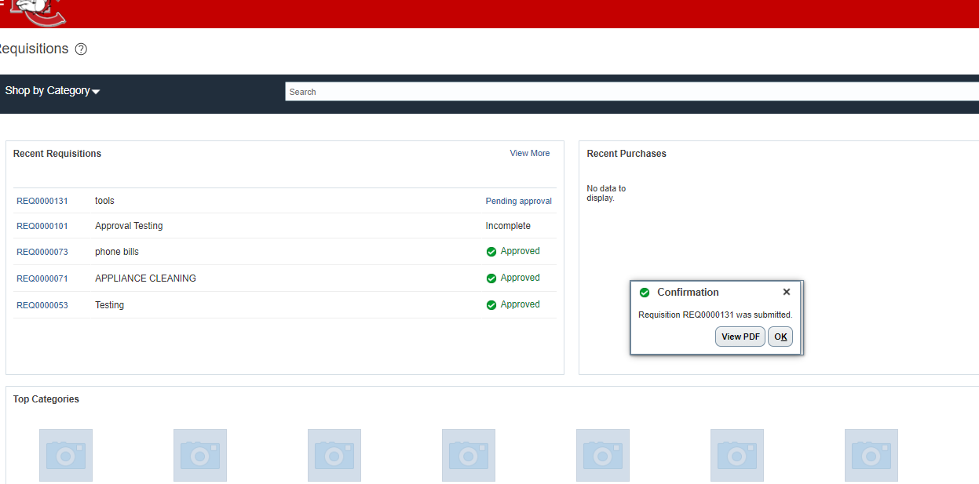
#13 Click Add to Cart
Do steps #1-13
for each item you
are ordering
#14 click the actual cart
If you click done it takes you back to the home page and its incomplete
#15 – Click Review
If you click Submit it takes you back to the home page and its incomplete

Slide 10
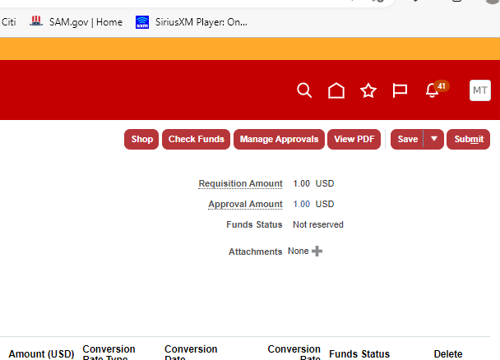
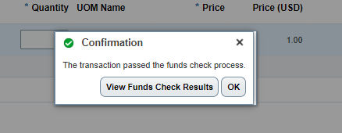
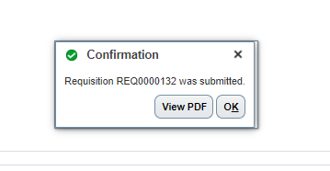
#17 You will receive a pop-up verifying
pass / fail funds check
#16 Click Check funds
#18 Click Submit
(if it passes funds check) or it will be incomplete until a budget transfer is done.
#19 you will receive a Req confirmation, and you are back on your home page

Slide 11
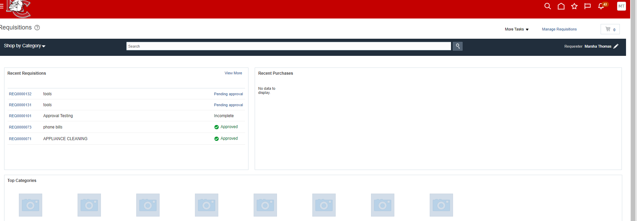
Requisition Home Page
Pending Approval - Click hyperlink to see approval line
Incomplete – this has not been submitted
Approved – this has been turned into a PO

Slide 12
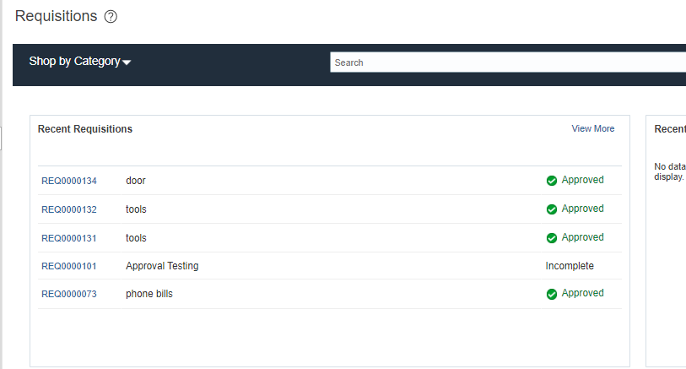
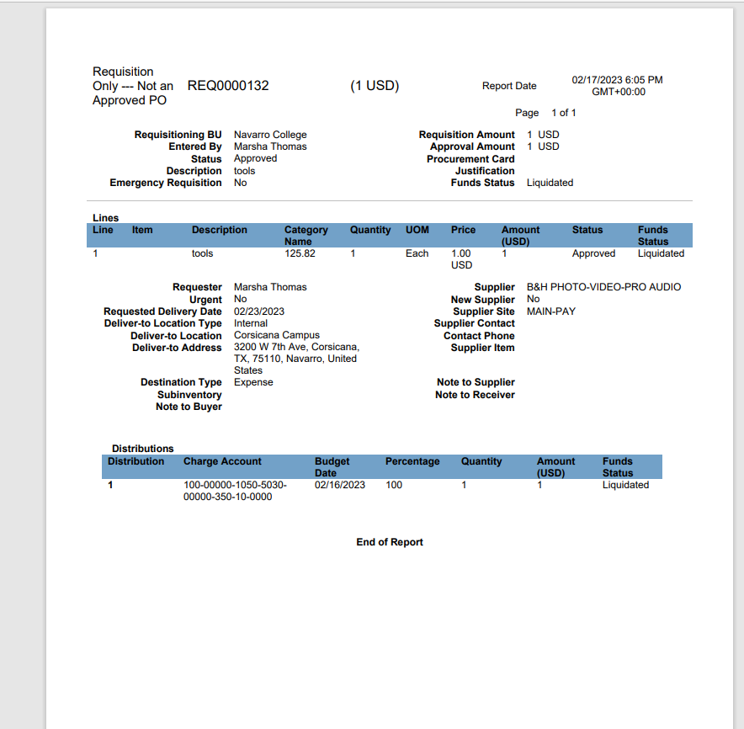
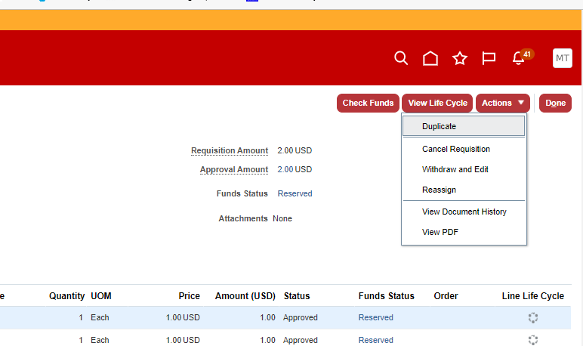
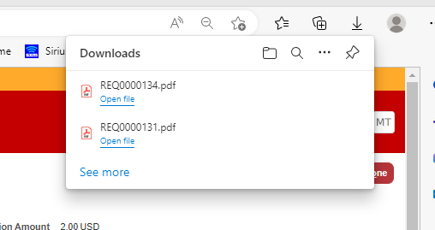
How do I Get a Copy of Requisition
Click Hyperlink
Click View PDF
Downloads Req.
NOTICE THIS IS NOT A PO you are NOT authorized to make a purchase

Slide 13
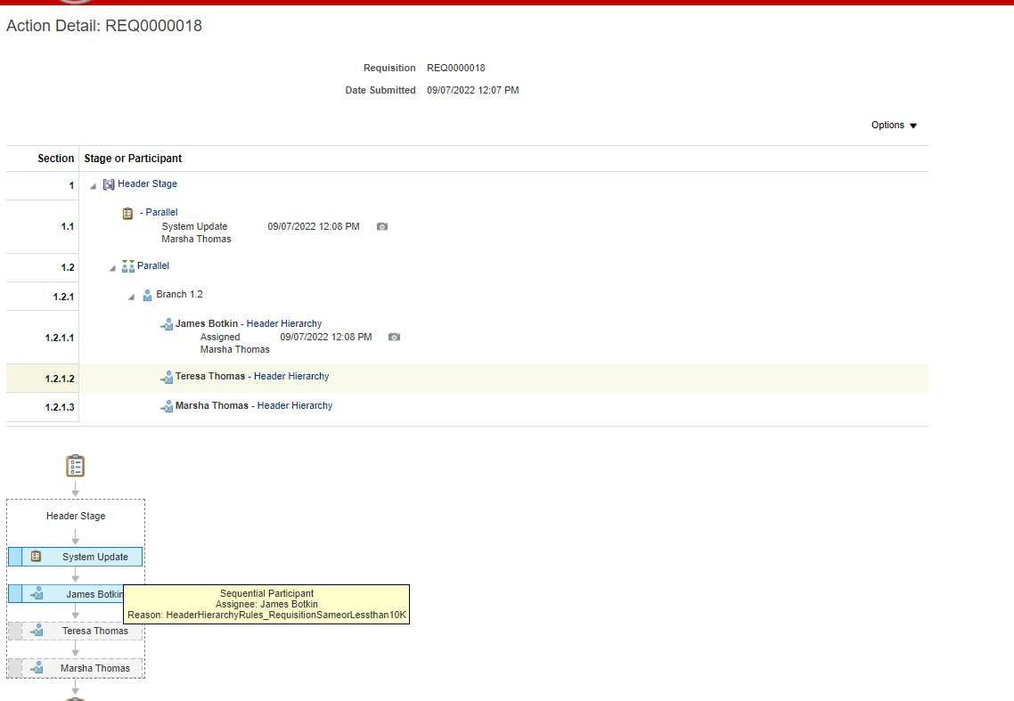
Clicking Pending Approval
Shows you where the approval is in real time.
Assigned = waiting on this manager (time / date)
Same as above showing the chain of Hierarchy and current location of approvals

Slide 14
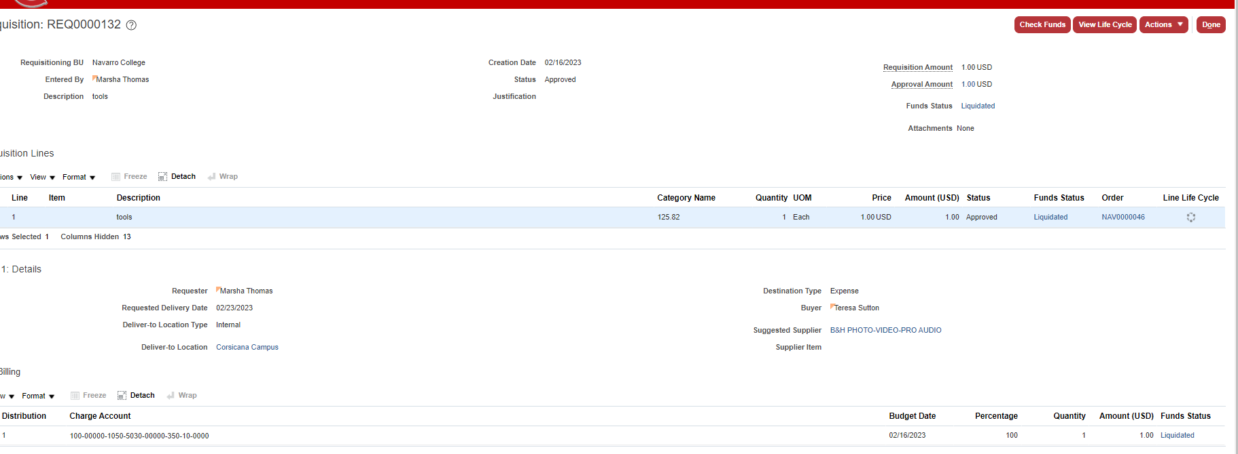
How do I Get a Copy of PO
#1 Click Hyperlink
Of an Approved Req.
FYI, the req could be approved but the PO process done by the purchasing officer may not be complete ☺
This process is done multiple times a day
#2 CLICK Hyperlink
NAV0000000
This is your PO

Slide 15
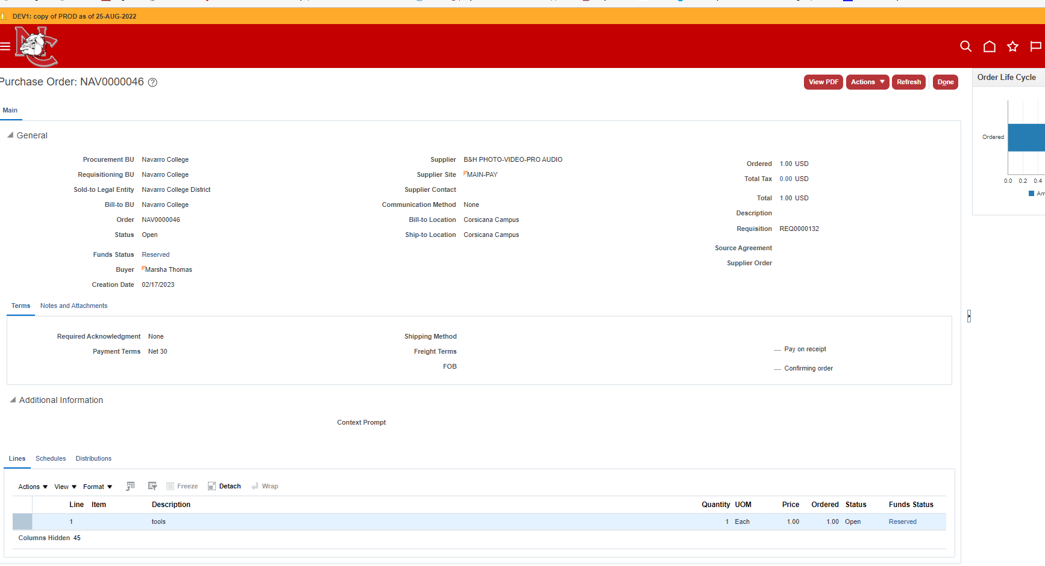
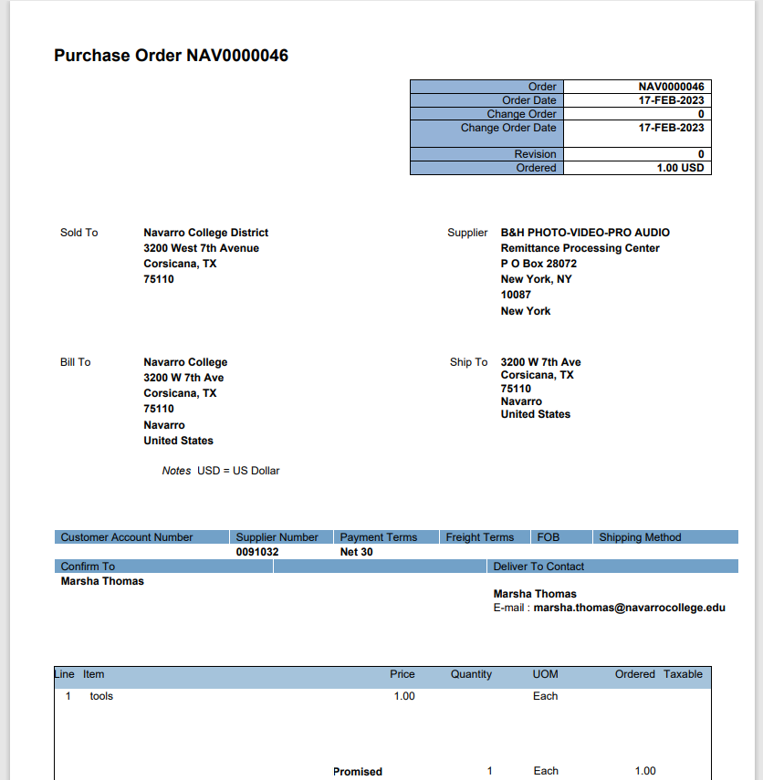
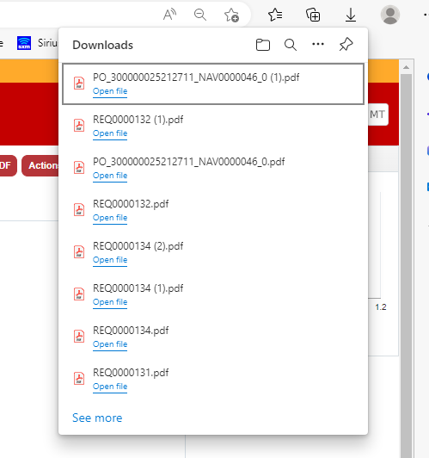
#3 View PDF
#4 Downloads
#5 Receive 2 pages
(cover sheet / PO )
PO numbers are 7 digits w/ NAV
NAV00000001

Slide 16
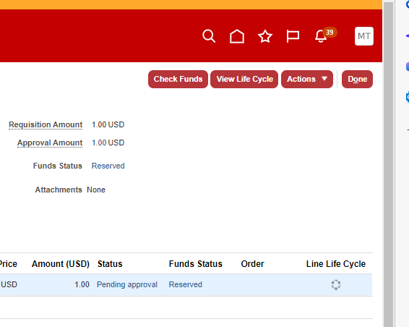
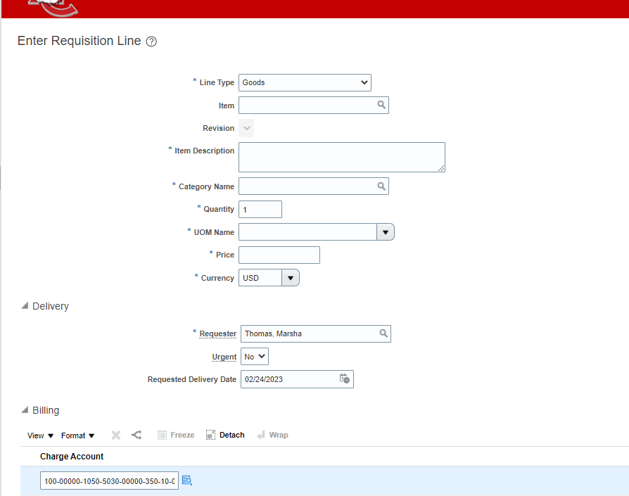
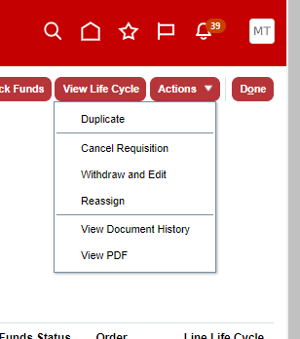
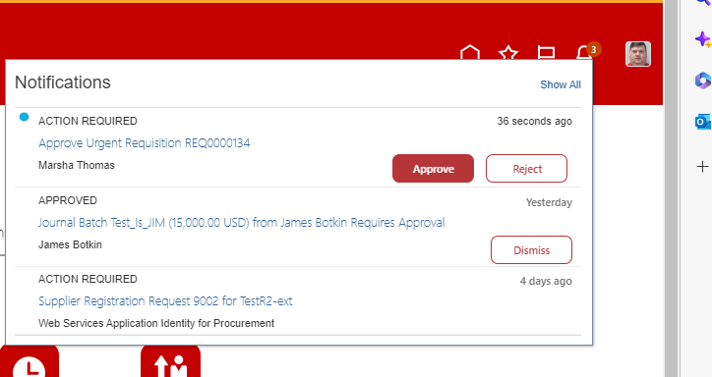
Tips Information Page
Life Cycle
Requisition has an Urgent Line whtat happens when you pick this ? The manager gets Urgent in the Action .. Nothing else!
Actions
Most screens have an action area to give options

Slide 17
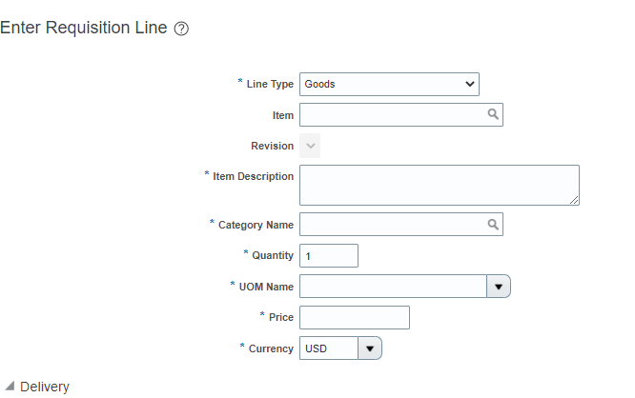
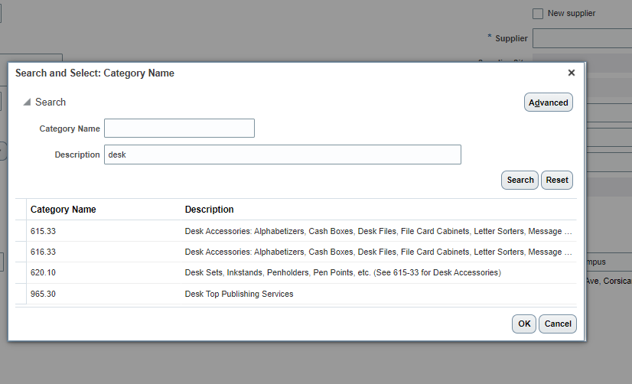
Tips Information Page
Category Name
Is a Number (not a name)
#1 click the magnify glass
#2 Advanced opens search options on many screens
#3 Enter description
Less letters / words the easier it finds things – click on the one that fits your needs the best.

Slide 18
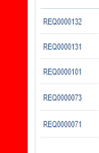
Split
You can take an invoice and divide it to as many gl accounts, as necessary. Opens more lines
Tips Information Page
Hyperlink
Term used for anything in blue – Opens to offer more information
View
Columns to add more information
To use these functions
Click the line
Pencil – Edit
X deletes a line
+ adds a line

Slide 19
Assets
In the description add the building and room number. If room does not have a number add description
Example – Bookstore.
Mark Favorites
*Star at the top of page for pages
*Favorite Vendors
*Favorite Category Names
*Favorite GL Accounts
Attach Quote
Attach your Amazon Order
To every requisition
!!!!! What I CAN Do !!!!!!

Slide 20
???? What I CANT do ????
Instead Create in Expense Module
Use MY PERSONAL card for anything other than
Mileage – Meals – Parking- luggage
Create a
Budget Transfer
When the funds are not available in the gl account to cover a requisition
Create a PO
For Citi Card purchase
Create a po for an associate / faculty reimbursement
Spend funds or Travel
and expect a reimbursement before the Authorization or Requisition
Instead Create in Expense Module
Use a single po with multiple invoices

Slide 21
Managers Approval

Slide 22
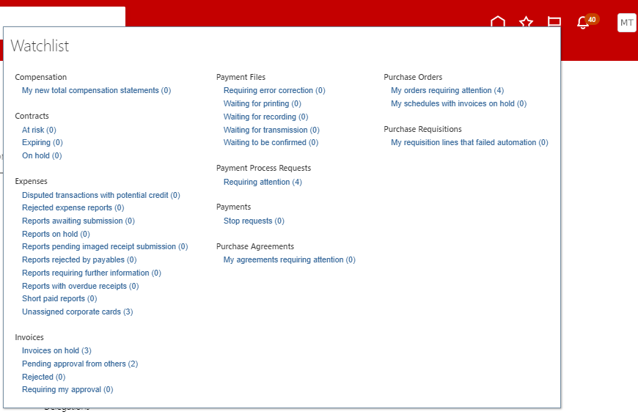
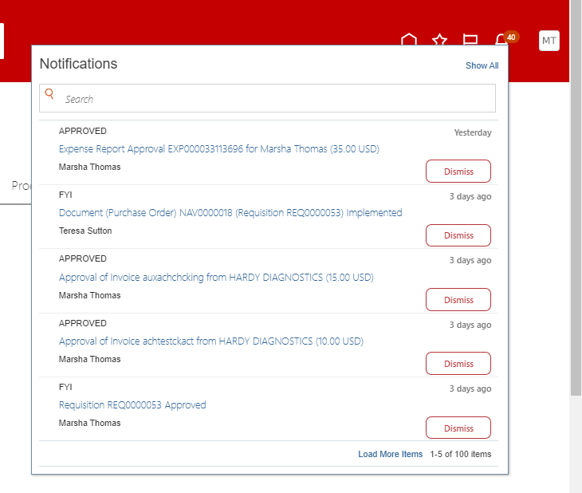
FLAG Notifications
BELL Notifications

Slide 23
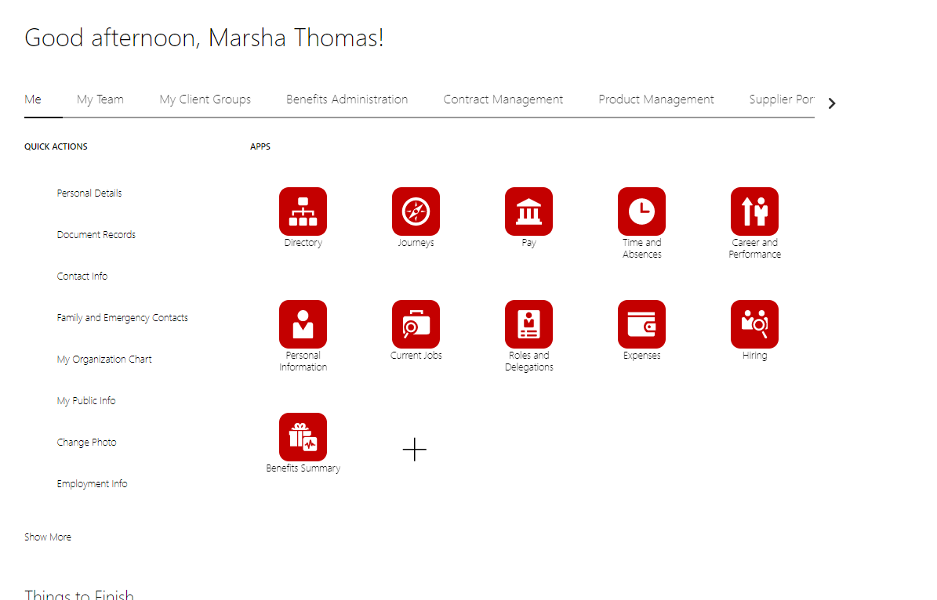
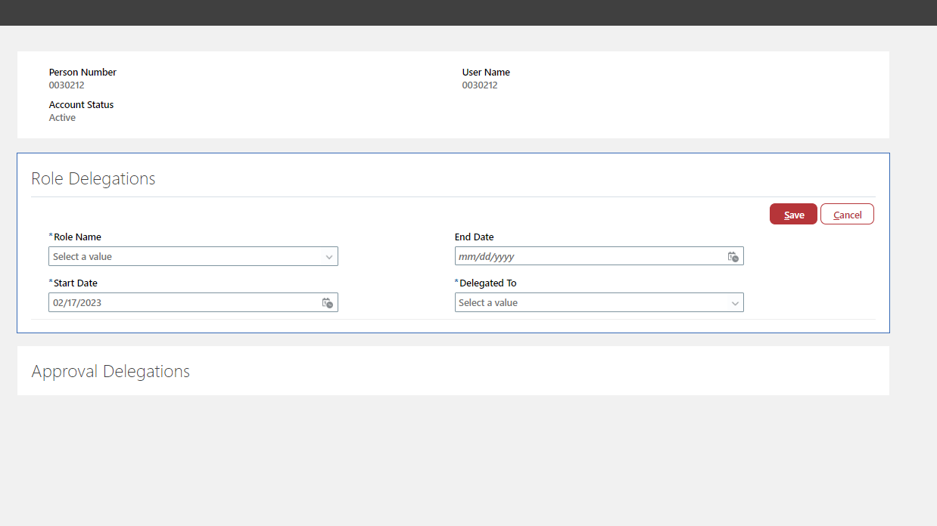
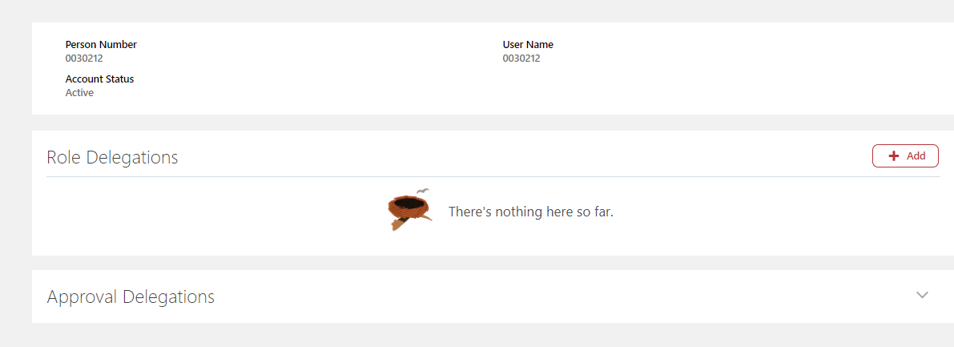
Delegate Approvals
While on
Vacation – Conference – Sick

Slide 24
Procurement Process Requisition to PO
By Procurement Officer

Slide 25
Invoices
Quotes
Packing Slips

Slide 26
All invoices MUST be sent to accounts payable for uploading into Oracle
accountspayable@navarrocollege.edu

Slide 27
Backup paperwork – will be connected to the requestion by YOU
Quotes, etc..
Packing Slips – will be uploaded by YOU when you Receive the items and tell Accounts Payable its ready to be paid
Invoices – Please email your invoices to Accounts Payable
If you upload multiple invoices, please indicate in the subject line
Example – Invoice or Multiple Invoices
DO NOT EMAIL PACKING SLIPS AND BACKUP PAPERWORK TO ACCOUNTS PAYABLE
Oracle will match your invoice to the po and pay automatically
If you don’t send the invoice to Accounts Payable the payment can’t be made.

Slide 28
Receiving Your Shipments

Slide 29
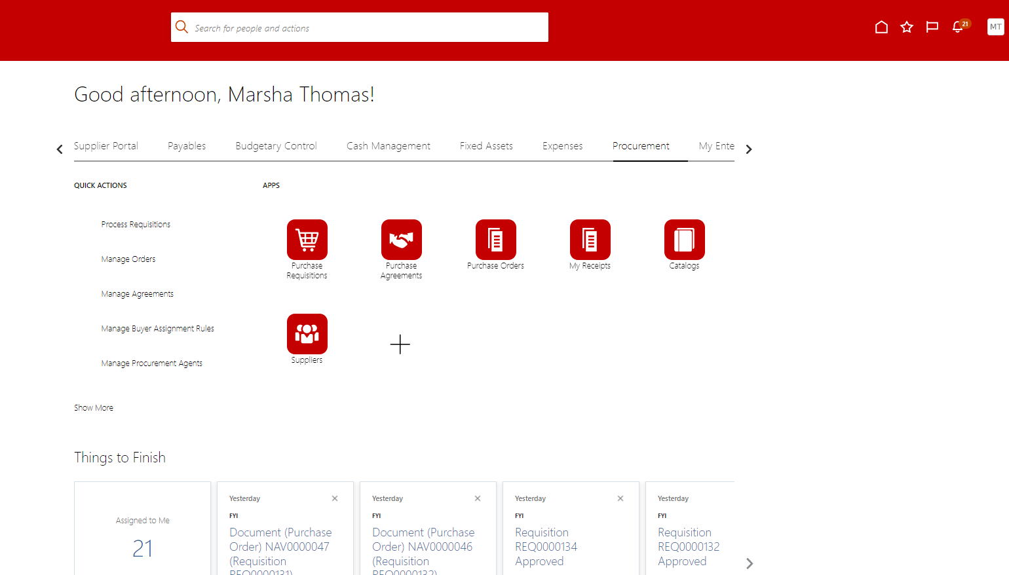

Slide 30
#3 drop box
Select Navarro College
#1 Requester name
#2 Drop Box
Select Any Time
#4 Search

Slide 31
#5 click line you want to receive in (line turns blue)
#6 click Receive
#7 Fill in Qty received
(you can receive partial, and it will only pay for what is on the invoice you have received)
#8 - type in packing slip box
Attached
If not attached (will be monitored)
N/A
#9 Mandatory Attachment
Packing Slip - picture of box & label or picture of product are all acceptable

Slide 32
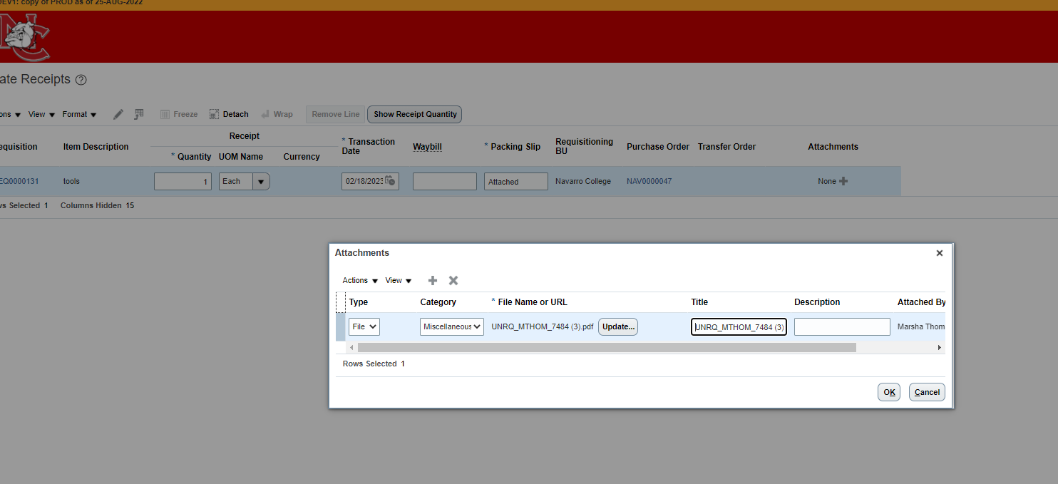
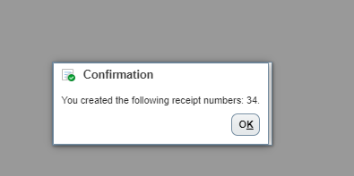
#10 Pop up box opens for attachment
This is a drag and drop area
**Multiple lines – you don’t have to upload the same thing for each line - you will have to type ATTACHED in each Packing Slip box or you will receive an error.
#11 click ok
PO #
#12 Submit
Packing slip attachment
#13 pop up box
Your invoice has been sent to Accounts payable for payment

Slide 33
Expenses

Slide 34
TRAVEL / REIMBURSEMENTS
TRAVEL for PERSONAL REIMBURSEMENTS
Oracle VS
Colleague
EMPLOYEES ARE NOT VENDORS
REQUEST FUNDS
TERM: AUTHORIZATION
GOES THRU APPROVALS
BECOMES AN EXPENSE
CREATE AN EXPENSE REPORT
GOES THRU APPROVALS
AUTOMATICALLY GOES TO AP
EMPLOYEES ARE VENDORS
REQUEST FUNDS
TERM: REQUISITION
GOES THRU APPROVALS
BECOMES A PURCHASE ORDER
CREATE DYNAMIC or TRAVEL FORM
GOES THRU APPROVALS
SEND TO AP
TA000033112664
PO 214685

Slide 35
Things to Note
Travel Reimbursed to Associate / Faculty
Completed in Expense Module
Associates/Faculty who travel weekly can do 1 expense report per week or month
There are NO open BPO’s for travel – each trip will require an authorization
(exception those who do weekly travel)
Reimbursements for College Classes will be done thru Expenses because Associates are NOT vendors

Slide 36
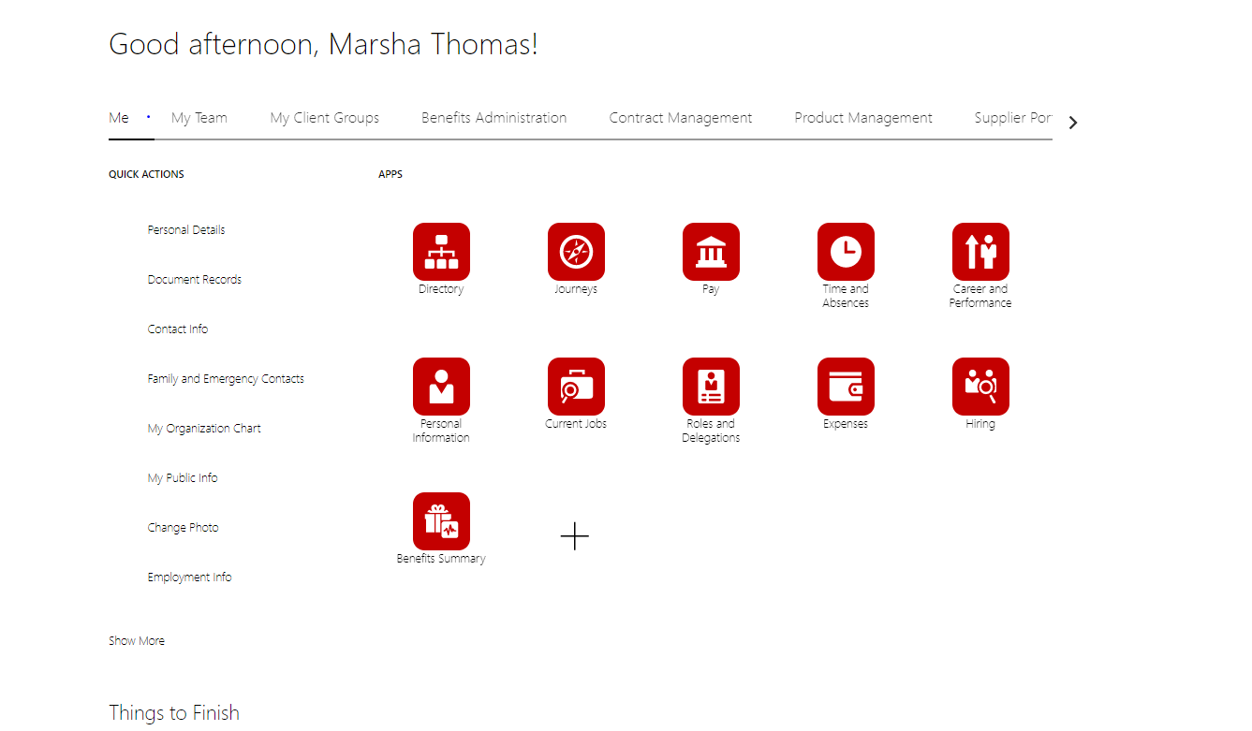

Slide 37
Authorization Request PO’s are no longer valid for Travel or Reimbursements
#2 Click Request Authorization
(you are ASKING for FUNDS for Associate or Faculty reimbursement)
#1 CLICK SNOWGLOBE ICON

Slide 38
#3 Purpose should be description w/ date
#4 Exp Location
Final destination
(auto generated as you type )
#5 Dates the expenses will occur
#6 Attachment
Itinerary, invitation, etc
#7 Click +
To itemize your expenses

Slide 39
https://gsa.gov
#8 4 Options for the Trip Expense
Staff Expense
Conference Expense
Grant Expense
Recruiting Expense
#11 Save & Create Another to add more expense lines
Save & Close to complete
#9 Type
Drop Box to drill down on the exact reason of reimbursement
#4 These boxes will change and correspond to the TYPE you choose (step2)
#5 You must change your GL account. If you are splitting a gl account to two different depts you will have to create this expense line two times and ask for the funds to go with each GL account.
#10 Amount you expect to pay out
NOTE*
If you spend more than asked for you will have to do another expense report for the difference
If you spend less than you have asked for, the remainder of the expense will need to be released by the budget manager (Teresa Sutton) to put the funds back into your budget.

Slide 40
#12 Submit to send for Approvals and goes thru funds check
Or Save and close to go back to later
Your Authorization shows as Pending Manager Approval
Note: if authorization fails funds check it will show as SAVED (you will need to do a budget transfer) & resubmit

Slide 41
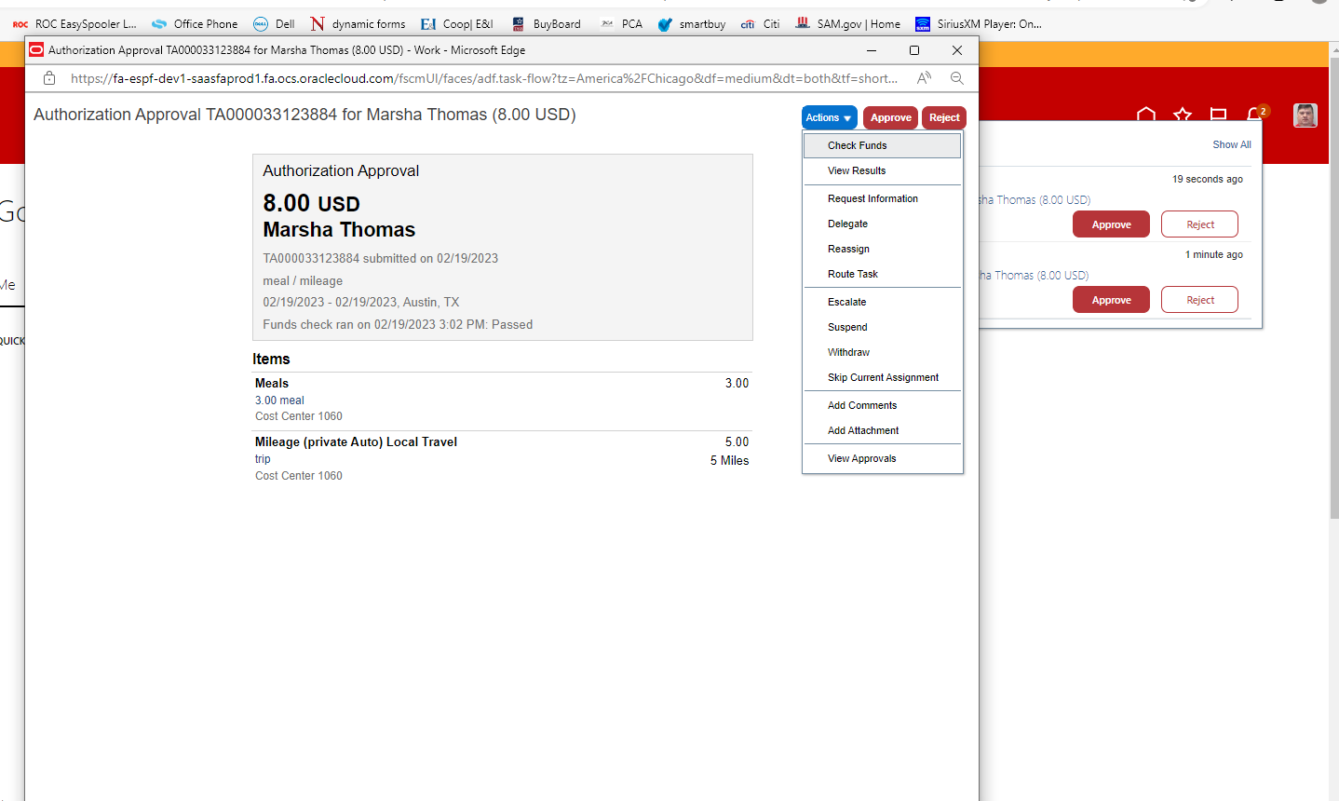
Manager Approval / A Manager can Reassign to another Approver
IF you click the blue hyperlink it opens this window to see details.

Slide 42
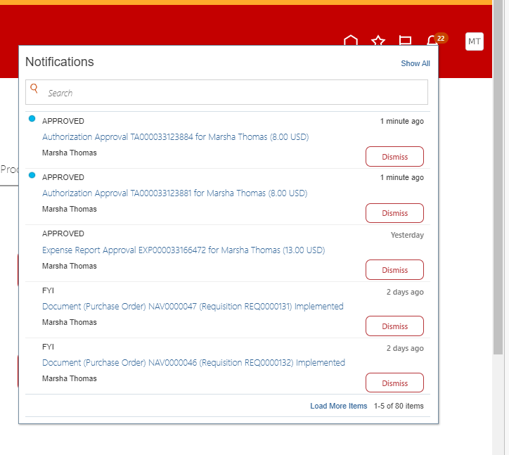
Your request to spend funds
AUTHORIZATION
is approved, you can now plan your trip.
Approved to take the trip

Slide 43
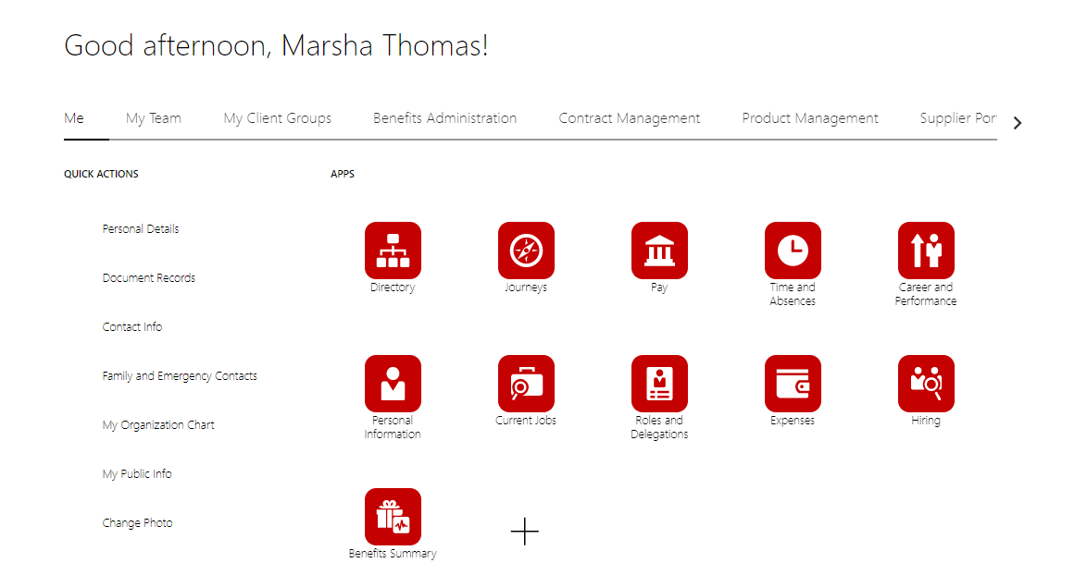
You are Back from the Trip and Need to Ask for Personal Reimbursement
Only Expense Reports
(NOT Authorizations) show on this turntable.. The more you do the more will be lined up across the page.

Slide 44
#1 Type in the same name as the request!
#2 Click to create expense lines
#4 Attach receipt(s) for this line charge
(drag and drop option)
#5 click Authorization (this is when you asked for funds) opens to a new box
#3 Page opens and changes expense lines depending on the Type you pick.
Make sure the gl account matches the account used when funds were requested before the trip

Slide 45
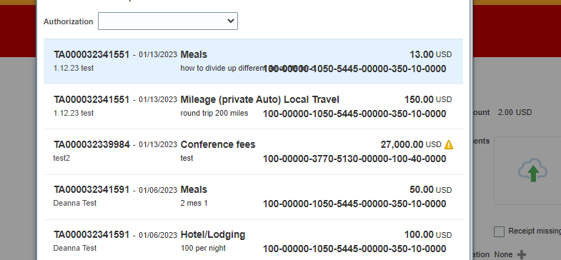
#6 Find your Original Request for this line item – click (turns blue) go to bottom of page and click ok
You need to know your TA# (Authorization #) to find the correct line / trip/ expense
Note: each line item shows here separately w/ the original Travel Authorization Number - TA000000000

Slide 46
The Authorization you selected from previous screen
Receipt(s) you attached earlier
#7 If you have more expense lines create another
or save & close

Slide 47
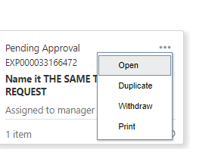
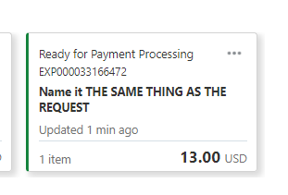
It has now changed to an EXPENSE
This is the Expense NUMBER
#8 Submit
Or save for later
If you receive an error, see next slide
This is why you name the Authorization and the Expense the same..
Also see next slide

Slide 48
If you forget to change the gl (fund) account when you created the Expense. You will receive an error. This must be fixed because the funds have been dedicated to this transaction

Slide 49
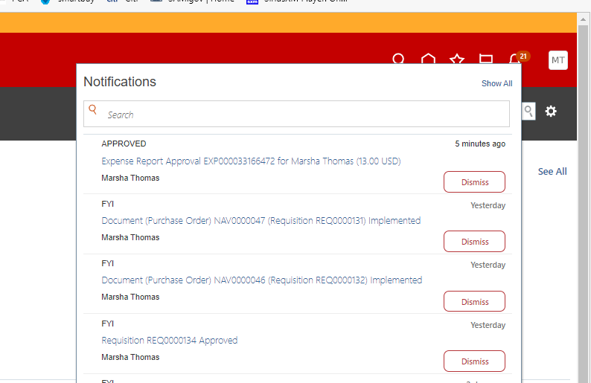
The person asking for the reimbursement will receive a message in the Bell Notification
Does not go back thru approval process since it was approved at Authorization level

Slide 50
How To Tips for Travel Expenses
Meals
Authorization (asking for funds) Include total amount of funds of all meals on one line expense
In the description break down the meals by day / bk, lunch, dinner / amount
Ex. 1/1/23 – bk @ 7$ Dinner @ $18 (gsa.gov) for allowable amount
During the Expense Report (asking of reimbursement) you will upload all receipts for the expenses
Mileage
During the Expense Report (asking of reimbursement) you will need Mapquet (or other maps) to upload
Your ending location is the destination town
During Expense Report - Make sure you click calculate at the top of the page
Missing Receipts
If a receipt is not attached your Expense will automatically go to Audit. We will look at your Expense and gather more information before approving expense
Auditing Expenses
Expenses are automictically pulled for various reasons to be Audited
Random audits are pulled by the system for us to Audit

Slide 51
Expense not on Original Authorization or Expenses over Authorized amount
You will receive an error if the expense is over authorized amount
You will have to create a new Authorization for the
missed Expense or Overage
You will need to input “Overage” in the Purpose line and add information in the description

Slide 52
Remaining Funds on Expense
In Oracle there are no PO’s to close to release funds.
You will need to create your Expense Report and after it is Approved
and ready for payment
email Teresa Sutton to release the remainder of funds.

Slide 53
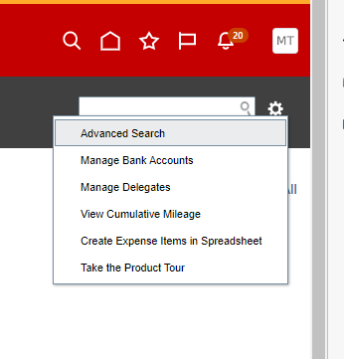
How to Delegate someone to do your Expenses
An Bell Notification will be sent to the person you delegated; they must accept before it will be complete. Both the user and the delegate can create expenses on the Users behalf.
To stop the delegation, click the x next to the +
? Not sure if its an option

Slide 54
If you have been delegated to do someone's expenses, you will see their name at the top of the page in a drop box. You must select which person the Personal Expense Reimbursement you are acting on.
You will receive this temporary message across the top of your screen

Slide 55
Citi Card
ALL Charges

Slide 56
TRAVEL / REIMBURSEMENTS
ALL CITI CARD CHARGES
NEW Oracle VS
OLD Colleague
EMPLOYEES ARE NOT VENDORS
REQUEST FUNDS BY OWNER OF CARD
TERM: AUTHORIZATION
GOES THRU APPROVALS
BECOMES AN EXPENSE
Owner of Card CREATEs AN EXPENSE REPORT
GOES THRU APPROVALS
AUTOMATICALLY GOES TO AP
EMPLOYEES ARE VENDORS
REQUEST FUNDS
TERM: REQUISITION
GOES THRU APPROVALS
BECOMES A PURCHASE ORDER
Owner of Card reconciles charges
Sent to Purchasing
TA000033112664 – EXP000000000
PO 214685

Slide 57
Citi Card Questions
The Associate responsible for the card reconciliation HAS to do the Authorization (request of funds)
Because all charges are attached to this person.. You will change the gl account to match the person needing the funds.
All charges are attached to the Associate number on the Citicard file (maintained by Procurement Officer)
I have placed the current Associate number on all Citicards that are currently sending me the reconciliation
Generic Dept Cards will be maintained by one person – all charges from that card will show on that Associates Expense page
Campus cards – Corsicana (10) Waxhachie (4) Midlothian (3) Mexia (3) Maintenance (10) will be maintained by one person on each campus and all charges will show on that persons Expense page.
ONLY THE PERSON RESPONSIBLE FOR THE PCARD RECONCILATION
CAN DO THE REQUEST FOR FUNDS
TO USE THE CITTICARD
(Citicard is NOT a Vendor )

Slide 58
Citicard Questionnaire
A Citicard request questionnaire will be available soon on MYNC – Staff Forms
This questionnaire will be attached to the Authorization by the Pcard Responsible Associate
The Pcard Responsible Associate can have these questionnaires on hand / uploaded
When its time to reconcile in March - we will do one on one training because
ALL FEBRUARY CHARGES WILL HAVE TO HAVE A NEW AUTHORIZATION
AND EXPENSED IN ORACLE before we can reconcile.
Please look for all your PO’s for February charges .. It will help if you have them

Slide 59
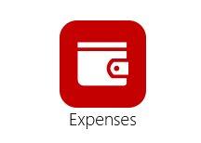
CITI CARD
REQUEST FUNDS IN THE EXPENSE MODULE by the Card HOLDER
Use the exact steps for Personal Reimburse Expenses
TERM: AUTHORIZATION
Goes thru approvals (follows the person not the gl account line - Procurement officer will change the approval line.
Once approved you will see it in your bell
Card can be issued / used for the charge once you have a TA # (approval)
(before you spend) Authorization # TA00000000
(after you spend) Expense # EXP00000000

Slide 60
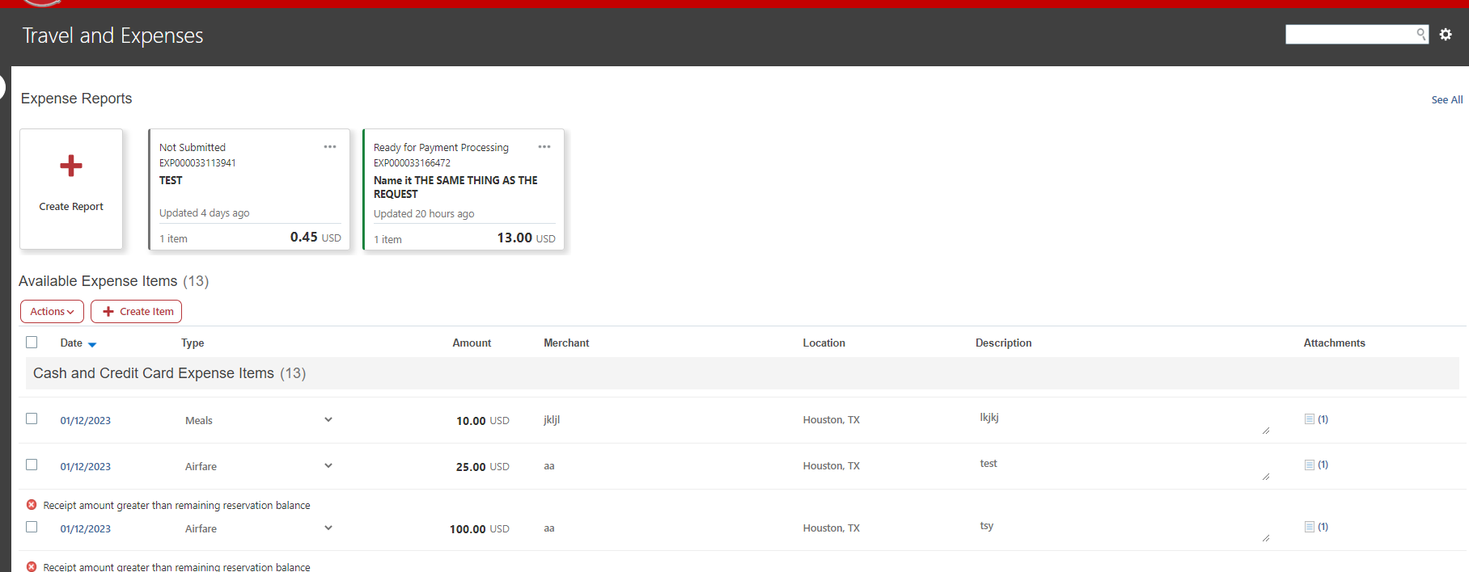
After the charge has been made it shows on the Pcard Responsible Party’s Expense page
Click line you would like to create Expense

Slide 61
Same steps as Personal Reimbursement
See next slides

Slide 62
#1 Type in the same name as the request!
#2 Click to create expense lines
#4 Attach receipts for this line charge
(drag and drop option)
#5 click Authorization – opens to a new box
#3 Page opens and changes expense lines depending on the Type you pick.

Slide 63
#6 Find your Original Request for this line item – click (turns blue) go to bottom of page and click
Note: each line item shows here separately w/ the original Travel Authorization Number - TA000000000

Slide 64
The Authorization you selected from previous screen
Receipt you attached earlier
#7 If you have more expense lines create another or save & close

Slide 65
It has now changed to an EXPENSE
This is the Expense NUMBER
#8 Submit
Or save for later
This is why you name the Authorization and the Expense the same..
Also see next slide

Slide 66
The person asking for the reimbursement will receive a message in the Bell Notification

Slide 67
Reconciliation
Future Slides after we go LIVE
We will work with each person one on one to Reconcile February charges in March.

